Slide 1
BIS Software Threats
Roman Danel
roman.danel@vsb.cz
VŠB – TU Ostrava

Slide 2
Agenda
Viruses
Trojan Horses
Worms
Hoax
Spyware
Phishing
Ransomware
Exploit
Botnet
Rootkit

Slide 3
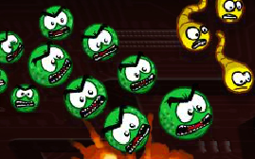
Viruses
Virus is a type of malicious software program ("malware") that, when executed, replicates itself by modifying other computer programs and inserting its own code.
Infected computer programs can include, as well, data files, or the "boot" sector of the hard drive. When this replication succeeds, the affected areas are then said to be "infected" with a computer virus..

Slide 4
History of viruses
1963 – first virus - F. Cohen, Pensylvania uni
1986 – first harmful virus
1988 – first antivirus - McAfee

Slide 5
Virus Classification
File virus
Boot, MBR, autorun virus
Cluster – change in FAT or NTFS tables
Network
Script
Stealth
Polymorphic
Macrovirus

Slide 6
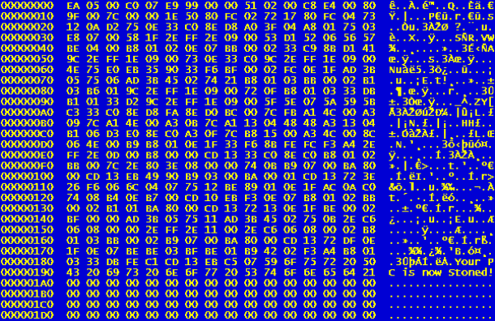

Slide 7
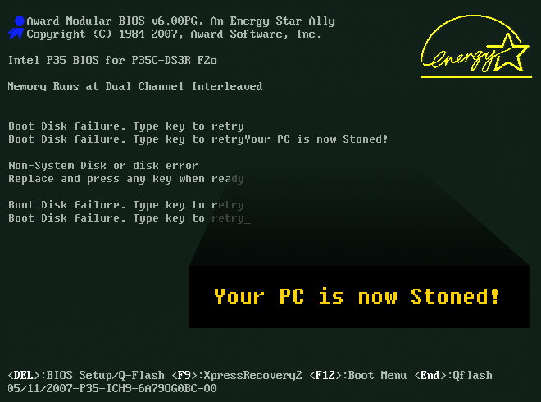

Slide 8
File virus
Overwriting some part of program
Parazitic – joins to the program without damaging it

Slide 9
Polymorphic virus
Changes the code of your body - prevents detection by finding the characteristic virus chain
Difficult detection

Slide 10
Stealth virus
They mask their activity and hide traces
Uses various mechanisms to avoid detection by antivirus software

Slide 11
Virus cathegories by impact
Non-destructive - visual or acoustic outputs
Annoying - padding letters, rotating screens ....
Fighting programs
Viruses that destroying data
Data-modifying viruses
Viruses sending data from your computer
Viruses trying to damage hardware
Logic Bomb - Starting from a certain date

Slide 12
Macroviruses
What is it a macro?
Office…
What is it VBA?

Slide 13
Macroviruses
Macro – commands for activity automation
VBA – Visual Basic for Application
Effects of location - often do not work in localized versions
Spread through e.g. .dot files (Microsoft Word)
Function in VBA: AutoExec, AutoOpen, AutoExit…

Slide 14
Macroviruses
Stealth – trying not to be seen in the macros list
Polymorfphic
Multiparity – use VBA, hey work in multiple programs
Multiplatform – they work on different OS

Slide 15
Ransomware
Ransomware is a subset of malware in which the data on a victim's computer is locked, typically by encryption, and payment is demanded before the ransomed data is decrypted and access returned to the victim.
The motive for ransomware attacks is nearly always monetary, and unlike other types of attacks, the victim is usually notified that an exploit has occurred and is given instructions for how to recover from the attack.

Slide 16
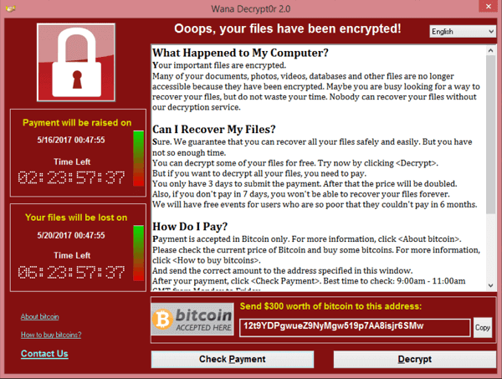

Slide 17
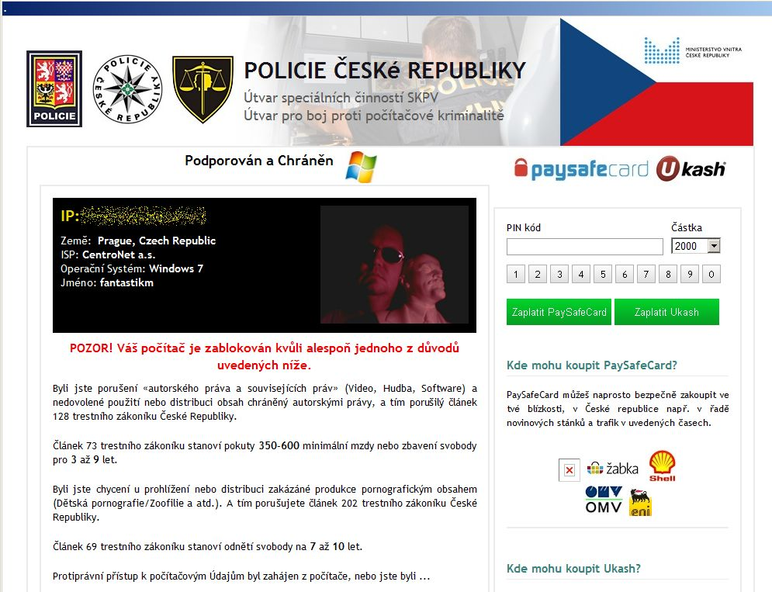

Slide 19
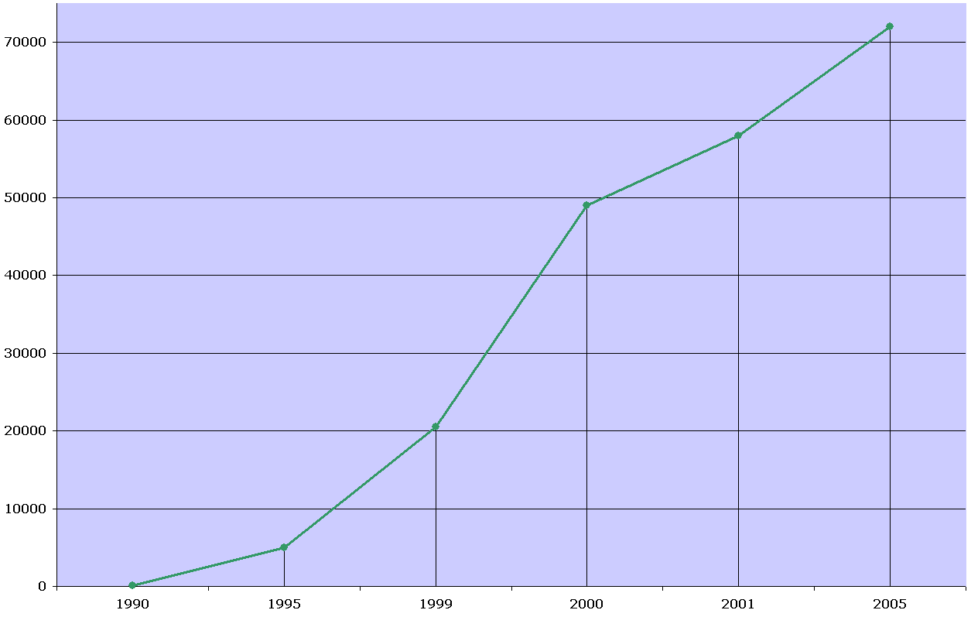
Number of viruses

Slide 20
Viruses Myths
Viruses are capable of destroying hardware
Viruses can spread in data files
Virus can be destroyed only by HD formatting
Mail-only viruses can be activated only by running an attachment (there is support for scripts in the body of the message or misinterpretations of the MIME message content that allowed the mass distribution of Win32: Nimda)

Slide 21
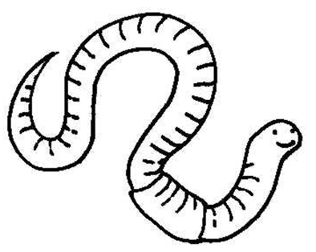
Worms
Network
E-mail

Slide 22
Worms
Worms use a mechanism based on a bug in the operating system, database, or web or mail client to spreading.
Unlike the virus, they do not need an intermediary.
Examples: Happy, PrettyPark, LoveLetter

Slide 23
History of worms
The first real worm - 1989 - Big Morris' worm, attacking much of the Internet at that time
2003 - return of classic worms - worldwide epidemic, use of the "DCOM exploit" security hole under Windows 2000 / XP. Common antivirus could not prevent infection, you need to install a Microsoft patch or firewall patch.

Slide 24
Division according Kaspersky Lab
File worms – they create files for their distribution primarily in system directories, these files with their names are often issued as system files
IRC worms – Use the IRC (an application layer protocol that facilitates communication in the form of text) property to send data in executable form; a very common way of spreading worms
Script worms

Slide 25
Spreading of worms
Files sent as e-mail attachments
Through a Web link or an FTP resource
Via a link sent in an ICQ or IRC message
Through peer-to-peer (P2P) networks
Some worms are spreading like network packets. The packets penetrate directly into the computer memory where the worm code is activated.

Slide 26
SQLSlammer worm
has exploited the security hole in Microsoft SQL Server. If the UDP packets on the 376-byte port 1433 (which is the size of the entire SQLSlammer worm) arrive at MS SQL Server with a non-secured security hole, the underrun buffer has been infected
SQLSlammer settled in memory and started generating and then sending more UDP packets to random IP addresses.

Slide 27
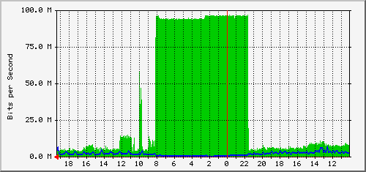
Graph showing extreme workload LAN 100 Mbit / s network UDP packets - SQL Slammer worm
použity podklady Zelenka, J., Hák, I.: Ochrana dat. Škodlivý software, skripta Gaudeamus Hradec Králové, 2005

Slide 28
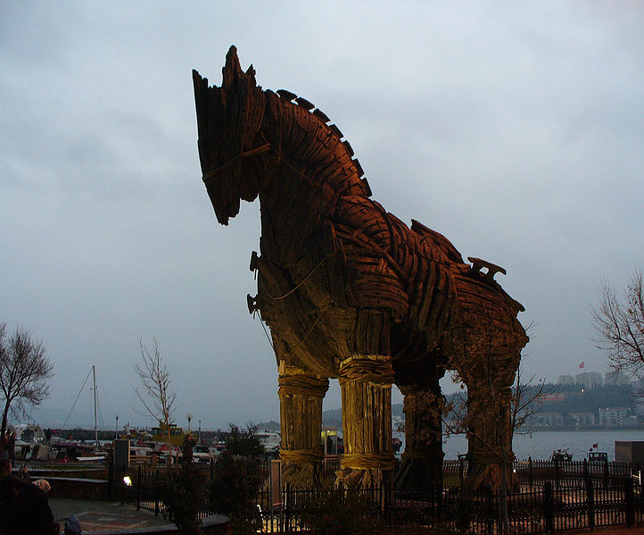
Trojan Horse

Slide 29
Trojan Horse
Trojan Horse – programs that, in addition to doing what they declare, do something else for us - malicious / unwanted.
Unlike viruses, they do not spread themselves.
Downloaders can also be included in this category.
Trojan-proxy - creates a proxy server for additional attacks from the infected computer.

Slide 30
Malware „trojan horse“
Keylogger – records keystrokes
Dialer – Dial-up (often foreign) connection without user's knowledge
Dropper – After running, it will let the other software be installed in the system and ensure its activating
Downloader – After starts, allows viruses and Trojans download from a predetermined location
Backdoor

Slide 31
Rootkit
a program that serves to mask certain attacker's activities and the presence of SW on the computer; attempt to remotely access computers with administrator rights
1986 Brain Virus - Captured attempts to read the boot sector
Windows and UNIX systems

Slide 32
Rootkit
User-mode rootkit
Kernel-mode rootkit
Firmware rootkit

Slide 33
Bloatware
Bloatware is a term that indicates the tendency for newer computer programs to leave more clues after their installation than necessary, have many unnecessary features that are not used by ordinary users, or offer little or no benefit to their users.
Also, software that is preinstalled on a purchased computer and usually is a time-limited trial version or a basic one for a trimmed or "beginner" version.

Slide 34
Exploit
A program that uses a known OS or application security vulnerability

Slide 35
Botnet
a program that is secretly installed on the user's computer contains a communication and control module and allows an unauthorized user to remotely control and use this computer to perform various commands.
Often uses IRC (Internet Relay Chat) chat channels.
Estimate - 47 million infected computers
Spam, phishing, DoS attacks ...

Slide 36
Password cracker
A program designed to remove passwords
The method of brute force or dictionary attack

Slide 37
Hoax and Spam
Hoax – mass-spread false alert, prank or mystification
Spam - unsolicited mass-forwarding (most often advertising) communications spread over the Internet

Slide 38
Types of hoax
Virus warnings
Description of other hazards
False requests for help
Rumors about mobile phones
Petitions and challenges
Fraudulent emails (eg from Nigeria)
Pyramid games
Chain letters of happiness
Funeral news

Slide 39
Phishing
Fraudulent technique used on the Internet to retrieve sensitive data (passwords, credit card numbers, etc.) from attack victim

Slide 40
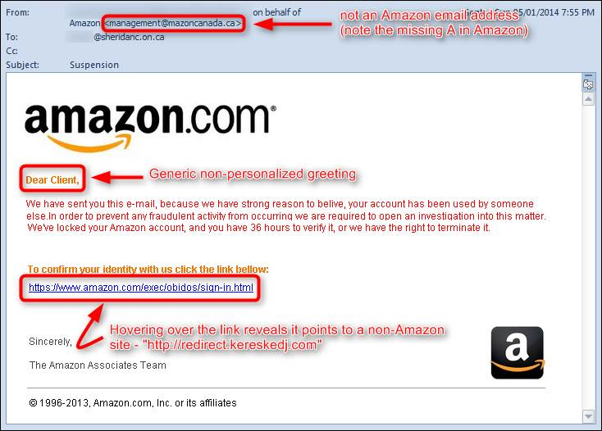

Slide 41
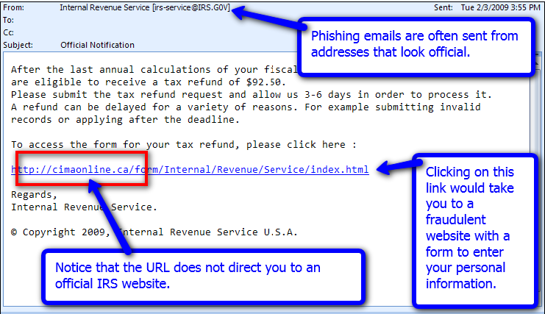

Slide 42
Spyware
Collects personal information, user activity, or data from the infected computer

Slide 43
Salami Attack
Fraud Technique - uses in error or small numerical leftovers to round off
Operations in large quantities
Hardly detectable

Slide 44
Programme Safety
Covert channels
Memory Channels - The process that legally writes is captured by the process that records the recorded data
Greedy programs – for its operations consume a large portion of system performance

Slide 45
Defensive mechanisms against harmful software
Antivirus programs, Anti-spyware
Single-time virus removal (removers)
Regularly installing updates and patches for operating systems (Windows and Linux)
System administration rules
Strong passwords
Application programs do not run under the system account
Turn off unused services, close ports,
Firewall

Slide 46
How the antivirus works?
Scan - search for virus code (strings)
Heuristic Analysis - Not dependent on a virus database, looking for suspicious instructions
Integrity Test - Check for changes if the virus has not started working
Resident protection

Slide 47
Heuristic Analysis
Passive
Active
The issue of "false positives„:
Too short a string for detection
Use incorrect sequences
Antivirus sensitivity too high

